Slide 1
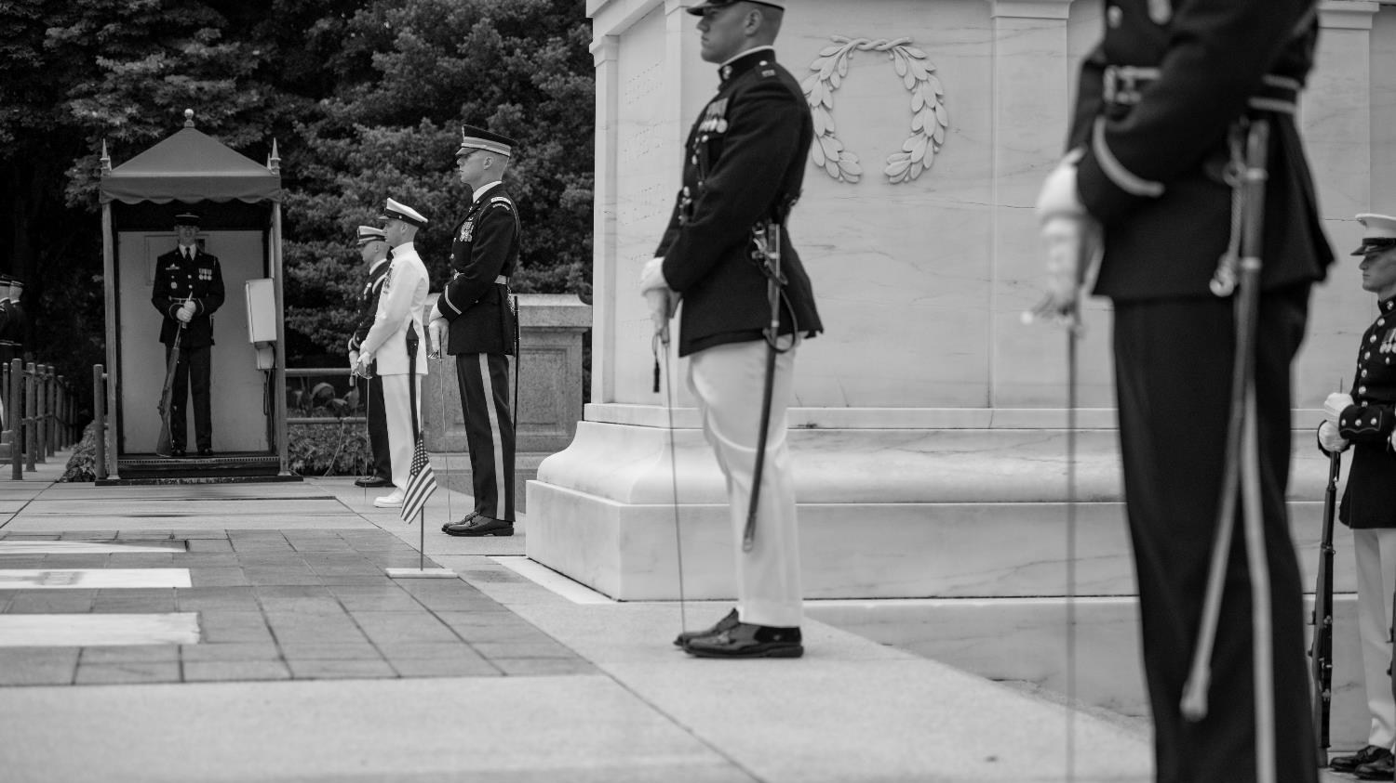
Background: Members of all five branches of the armed forces participate in a Memorial Day wreath-laying at the Tomb of the Unknown Soldier at Arlington National Cemetery, 2018. (ANC/Elizabeth Fraser)
WHO’S BURIED AT THE TOMB OF THE UNKNOWN SOLDIER?
A HISTORY MYSTERY
ARLINGTON NATIONAL CEMETERY
HISTORY EDUCATION SERIES

Slide 2
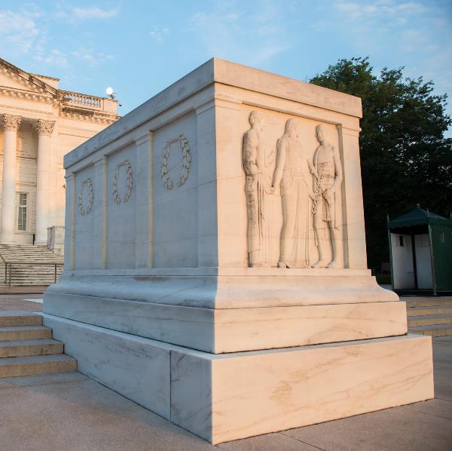
QUESTIONS TO ANSWER
Who’s buried at the Tomb of the Unknown Soldier?
Why is that person “Unknown”?
Why is he buried there?
When was he buried in the Tomb?
Where was he before coming to the Tomb?
The Tomb early in the morning. (ANC/Elizabeth Fraser, 2018)
ARLINGTON NATIONAL CEMETERY HISTORY EDUCATION SERIES

Slide 3
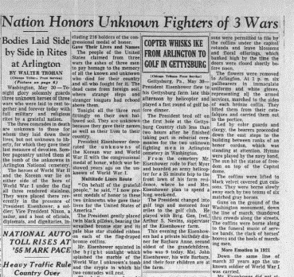
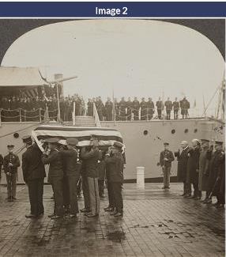
UNRAVELLING THE MYSTERY
Clues are pictures or quotes
Where did the clue come from?
Work in groups
Keep track of the clues you use
ARLINGTON NATIONAL CEMETERY HISTORY EDUCATION SERIES

Slide 4
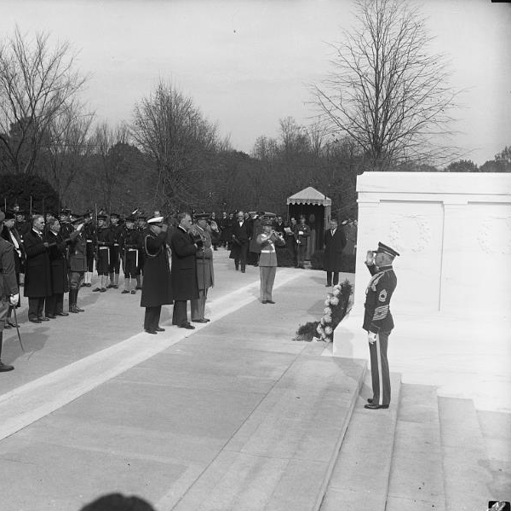
CLASS DISCUSSION
Who’s buried at the Tomb of the Unknown Soldier?
When was he buried at the Tomb?
Where was he before coming to the Tomb?
Why is he “Unknown”?
Why was the Tomb built?
President Franklin D. Roosevelt participates in an Armistice Day wreath-laying ceremony, 1933. (LOC)
ARLINGTON NATIONAL CEMETERY HISTORY EDUCATION SERIES

Slide 5
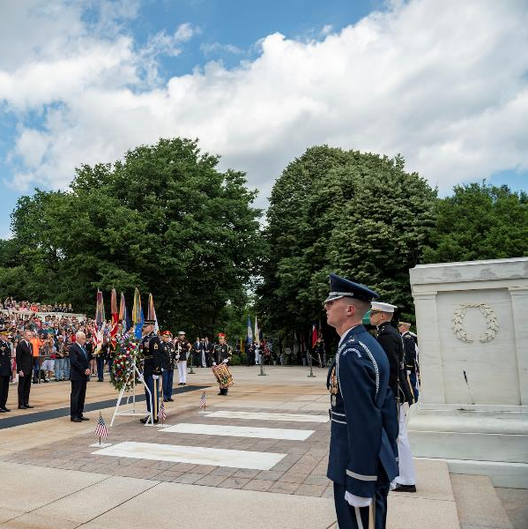
WHAT HAS CHANGED?
Vice President Mike Pence participates in a Memorial Day wreath-laying ceremony, 2019. (ANC/Elizabeth Fraser)
President Franklin D. Roosevelt participates in an Armistice Day wreath-laying ceremony, 1933. (LOC)
ARLINGTON NATIONAL CEMETERY HISTORY EDUCATION SERIES

Slide 6
WHY ARE THERE 3 MARBLE BLOCKS?
Second set of clues
Work in the same groups
The crypts to the west of the Tomb. (U.S. Army/Gabriel Silva, 2020)
ARLINGTON NATIONAL CEMETERY HISTORY EDUCATION SERIES

Slide 7
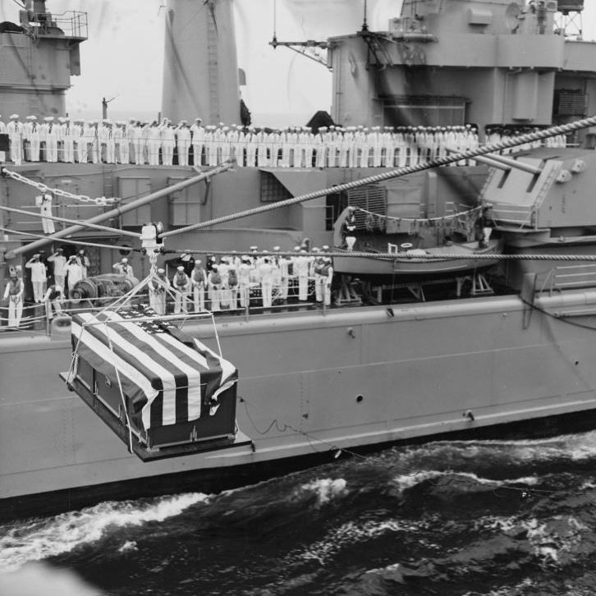
Right Crypt
What’s written on the crypt?
Who’s buried in the crypt?
When was he buried there?
Where was he before coming to the crypt?
Why was he buried in the crypt?
How is he different from the first Unknown?
A casket is transferred to the USS Canberra before the World War II selection ceremony in 1958. (NHHC)
ARLINGTON NATIONAL CEMETERY HISTORY EDUCATION SERIES

Slide 8
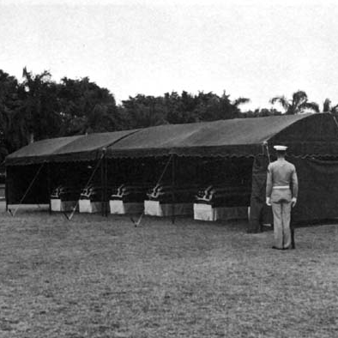
Left Crypt
What’s written on the crypt?
Who’s buried in the crypt?
When was he buried there?
Where was he before coming to the crypt?
Why was he buried in the crypt?
How is he different from the first Unknown?
Flag-draped caskets of unidentified dead at Hickam Air Force Base in Hawaii. (DOD, 1958)
ARLINGTON NATIONAL CEMETERY HISTORY EDUCATION SERIES

Slide 9
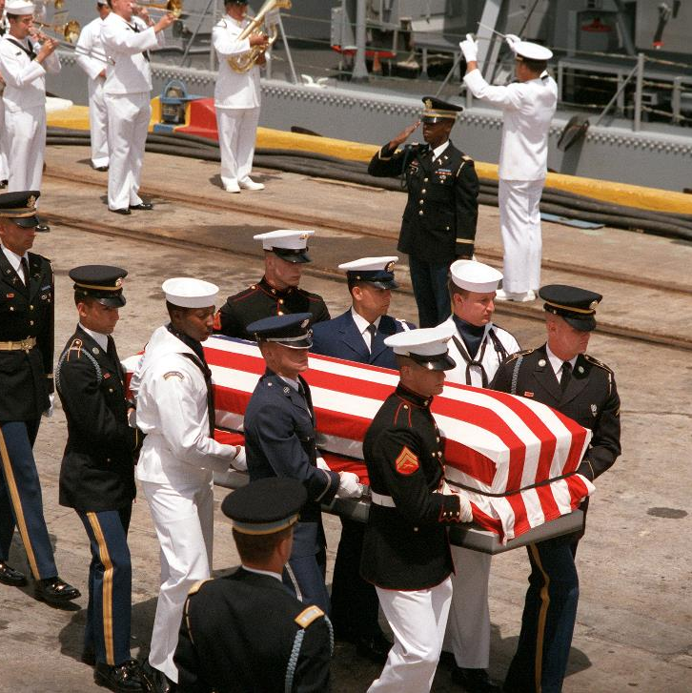
Center Crypt
What’s written on the crypt?
Who’s buried in the crypt?
When was he buried there?
Where was he before coming to the crypt?
Why was he buried in the crypt?
How is he different from the first Unknown?
An honor guard carries the casket of the Vietnam War Unknown from the USS Brewton to a hearse in May 1984. (NARA)
ARLINGTON NATIONAL CEMETERY HISTORY EDUCATION SERIES

Slide 10
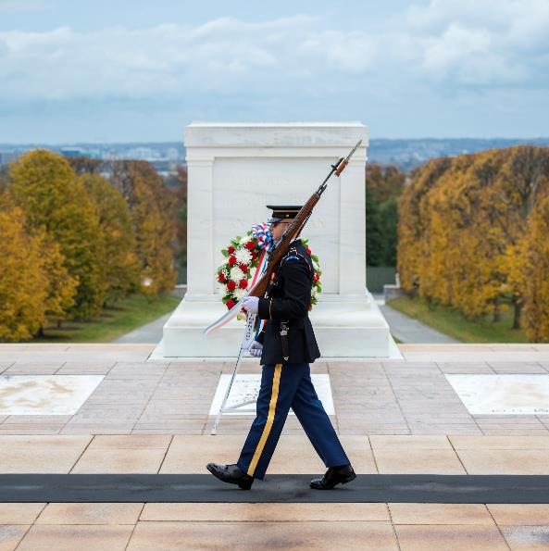
REFLECTION
How has the Tomb changed over the years?
Why is the Tomb been so important to Americans?
How do visitors show respect at the Tomb?
What does the Tomb of the Unknown Soldier mean to you?
A Tomb guard walks the mat while guarding the Tomb of the Unknown Soldier, 2018. (LOC/Elizabeth Fraser)
ARLINGTON NATIONAL CEMETERY HISTORY EDUCATION SERIES

Slide 11
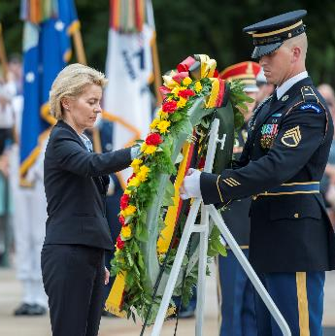
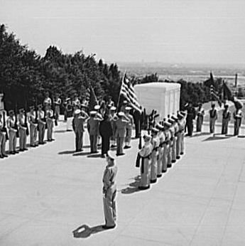
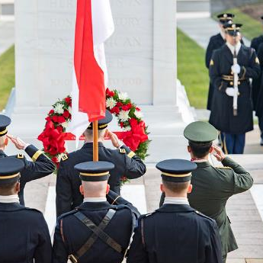
FOREIGN VISITORS
Over the years, many foreign leaders have laid a wreath at the Tomb when visiting Washington, D.C.
Why do leaders from other countries want to honor the American Unknown Soldiers?
German minister of defence Ursula von der Leyen visits the Tomb, 2018. (ANC)
Indonesian army chief of staff General Andika Perkasa visits the Tomb, 2020. (ANC)
King George VI of the United Kingdom visits the Tomb, 1939. (LOC)
Liberian president Edwin Barclay visits the Tomb, 1943. (LOC)
ARLINGTON NATIONAL CEMETERY HISTORY EDUCATION SERIES

Slide 12
TOMB OF THE UNKNOWN SOLDIER:
A TIMELINE
1914-1918
World War I
1939-1945
World War II
1958
World War II and Korean War Unknowns interred
1984
Vietnam War Unknown interred
1900
1950
2000
1955-1975
Vietnam War
1998
Vietnam Unknown identified and disinterred
1921
Tomb of the Unknown Soldier dedicated
1950-1953
Korean War
*Conflict years indicate American involvement

